Slide 1
Wakeland Sports Medicine
Athletic Training Room
Policies and Procedures Meeting

Slide 2
Website
Most information can be found/accessed on our website, including this powerpoint presentation.
www.wakelandsportsmedicine.weebly.com

Slide 3
Injuries
Let us see the injury first—no injury is too small
Unless you are injured during practice, we evaluate injuries during morning treatment time. This is from 7:30-8:15.
After we evaluate the injury we can better determine if the injury needs to be seen by a doctor.
If you go to a regular doctor, there is a chance you will be out 6-8 weeks. We are unable to let you come back and participate until we have a written release.
If you go to your family doctor or the emergency room, you must bring back a doctor note if we have no note on file. You will NOT be able to participate until we receive that note.

Slide 4
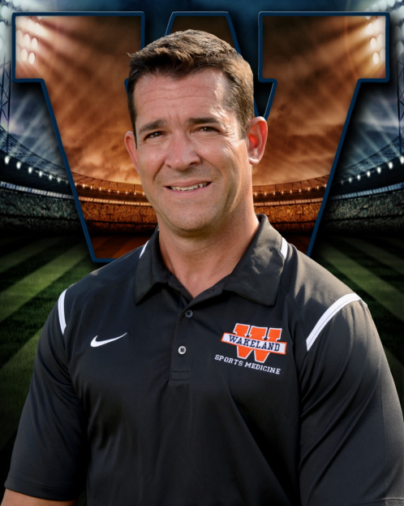
Dr. Dan Maurer
You have a choice on which doctor you go to, but our team doctor is Dr. Dan Maurer. Dr. Maurer is an orthopedic surgeon. Just because he is a surgeon does NOT mean he will do surgery on your child. It has been our experience that Dr. Maurer will take the best course of treatment and will try to go the non-surgery route if possible.
Dr. Maurer puts a lot of time and effort into covering our school. He is at every Friday night football game, and is on call for us 24/7. Dr. Maurer also comes to school every Monday morning we are in session at 7:30 am.
Dr. Maurer holds an injury clinic on Saturdays during the fall from 8-10 am at his office.

Slide 5
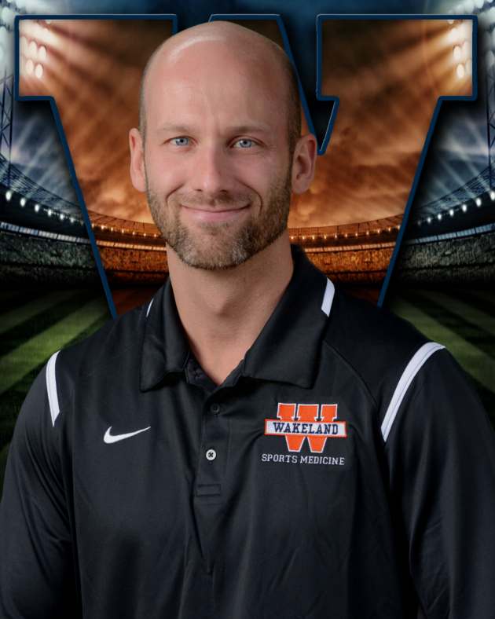
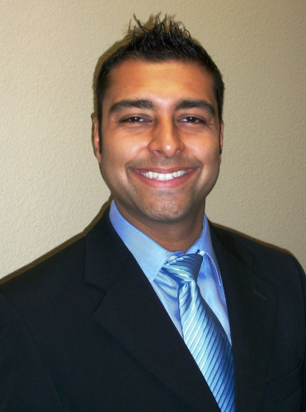
Dr. Matt Schindlbeck & Dr. Puneet Arora
We have two team chiropractors, Dr. Matt and Dr. A.
Dr. Matt will attend many of our Friday night football games.

Slide 6
Insurance
In the event of an injury, the school has a policy with very basic coverage. It will cover a percentage of what your personal insurance does not cover.
Do not depend on this secondary insurance to cover your medical expenses.
If you have a claim for school insurance, it must be filed within 30 days of the injury.
It is a good idea to have another supplemental policy along with your regular policy; due to the fact that at any given time in athletics anything can happen.
Information on the FISD Student Accident Insurance Program can be found on the district website:
http://www.friscoisd.org/departments/risk-management/student-accident-insurance

Slide 7
Athletic Paperwork
Must have completed EVERY year to compete in FISD athletics. It must be completed on or after May 1st. There will be no exceptions for this.
Log in to https://friscoisd.rankonesport.com/Main/Default.aspx
Use the 6-digit Frisco ID for EACH student.

Slide 8
Athletic Paperwork
Follow the instructions:
WHS-Online Athletic Packet instructions
At the very bottom of each form, make sure to enter e-mail address and hit SUBMIT. You will receive a confirmation e-mail for each completed form.

Slide 9
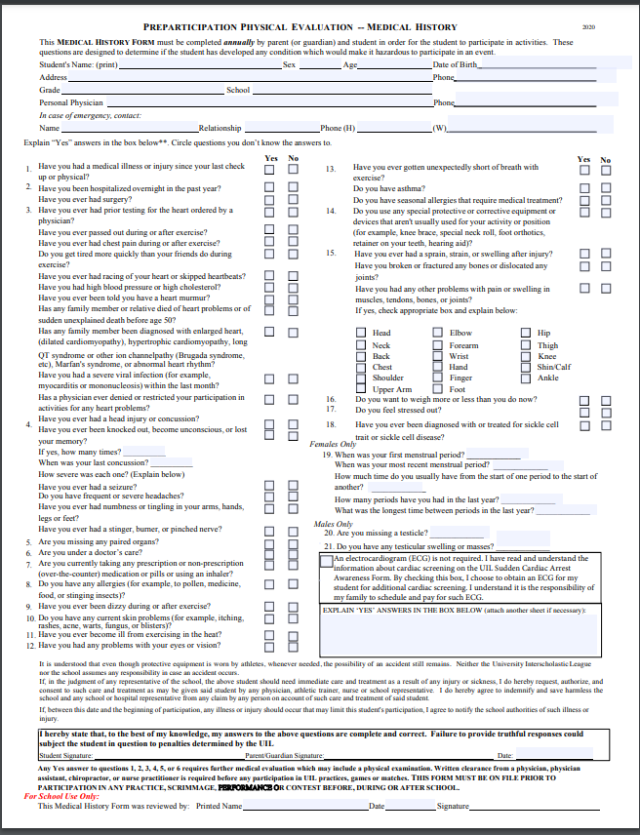
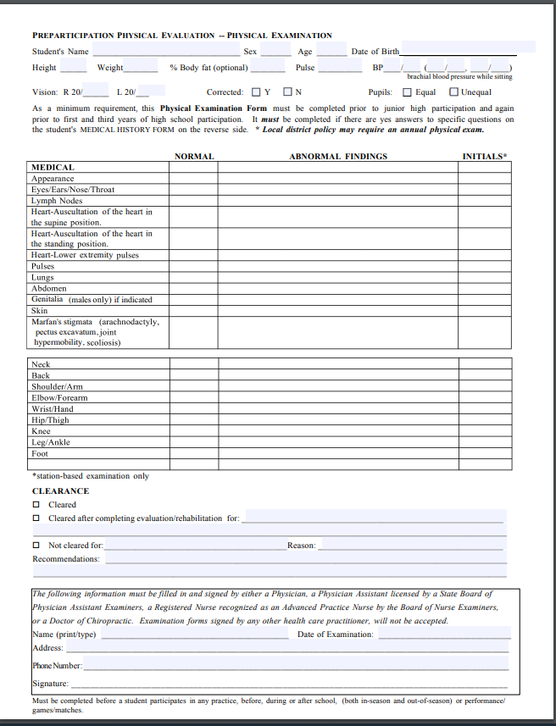
Physicals
Must have a completed physical EVERY year to compete in FISD athletics. They must be dated on or after May 1st. There will be no exceptions for this. Please type in demographic information before printing. (show physical)
Turn these in to YOUR coach (fall season if more than one).

Slide 10
ImPACT Test
Concussion Baseline Testing Tool
Starting with the 2016-17 school year, EVERY athlete, manager, filmer, and student athletic trainer will complete this test.
Our doctors request that this test be taken at school, in the presence of a supervising coach.

Slide 11
Staph Infections
Here in FISD we do everything we can as far as cleaning, disinfecting, and sanitizing to stop staph infections. We can do many things, but it does no good without help from the athletes and the parents.
Clothes must be clean, and the athletes must be clean. The athletes must shower with soap after each workout period, and the athlete must clean their workout clothes after each workout. This service is provided by the coaches for certain sports. Check with your head coach.
If the athlete has an open wound in the skin, it must be covered. It doesn’t matter if the cut is big or small. If there is a break in the skin, staph can get into it.

Slide 12
Staph Infections cont.
Cleanliness is the best defense against staph.
If the athlete has a sore that is questionable, have the athlete come to us to look at it. Staph is a serious problem and if treated early is easily defeated. But, if it goes untreated, it can be life threatening.

Slide 13
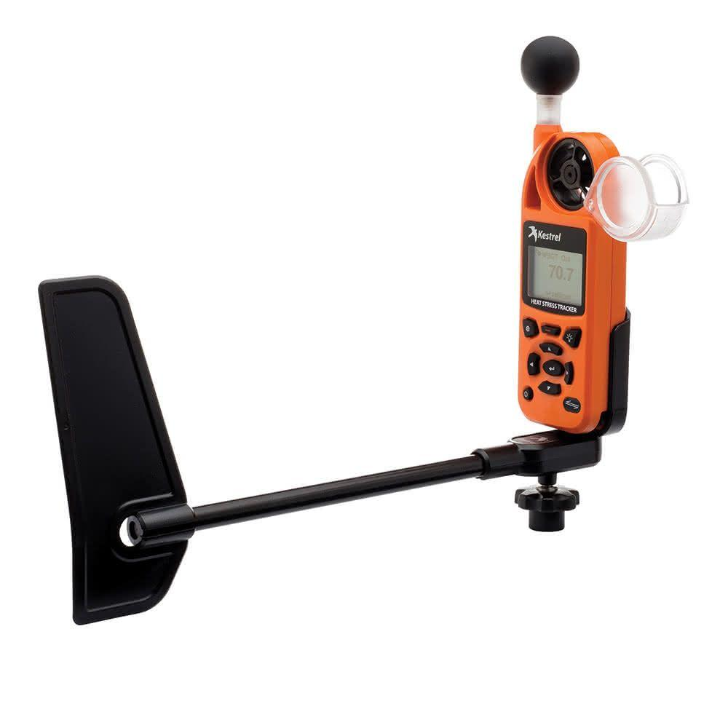
Heat
Policy and procedures are on the Wakeland Sports Medicine website as well as on the web under Frisco ISD athletics.
At home, you can help us out by increasing water, sports drink intake and decreasing carbonated drink intake such as Coke, Dr. Pepper, Sprite, etc…
We suggest during the ‘heat’ season, to eliminate all carbonated drinks from the athletes’ diet.
We utilize a ‘Kestrel’ device to help monitor heat stress conditions.

Slide 14
Heat—Football specific
To combat the heat, we do several things:
We have over 100 gallons of drinking water at every practice.
We have the luxury of using the indoor when temperatures get above a heat index of 110 degrees.
We use ice buckets with ammonia to cool the athletes down.
We have breaks in practice for the athletes.
Athletes can get water at any time during the workouts.
The athletes are under constant supervision by TW, Coach Langford and other coaches and student athletic trainers.

Slide 15
Lightning
At the first sign of lightning, everyone is off the field and in to shelter.
We use the flash/bang method along with a weather monitoring service linked directly to our cell phones.

Slide 16
Concussions
3 grades of concussions, I, II, III
With any grade of suspected concussion, the athlete will not be allowed back into activity until they have seen a licensed physician. This is a UIL regulation.
The UIL/FRISCO ISD Concussion Management Protocol and Return to Play Release Form must be completed by the treating physician and returned to TW or Coach Langford before return to play for ANY SUSPECTED concussion.
Remember, athletes will get headaches just because of the nature of the game, and there is a difference between headaches and head injury. Let us evaluate them.

Slide 17
Conclusion
Most of this information can be found on the Wakeland Sports Medicine website. You can access this directly at: www.wakelandsportsmedicine.weebly.com or from a link on the wolverine club page.
We are doing everything we can to make this an injury free year, but in sports injuries do happen. As a Wakeland staff, we try to minimize this in every way possible.
If you have any questions or concerns, please feel free to contact us.

Slide 18
Contact Information
Richard Womble (TW), M.Ed., LAT
wombler@friscoisd.org
469-633-5776
Rachel Langford, M.Ed., ATC, LAT
langforr@friscoisd.org
469-633-5766
** Please note, the fastest and most efficient way to make initial contact with either of us is through e-mail. We do not see our office phones on a regular basis due to teaching duties, practices and games, but we are able to retrieve e-mails on our cell phones and classroom computers.

